Slide 1
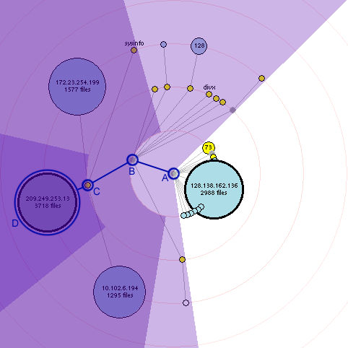
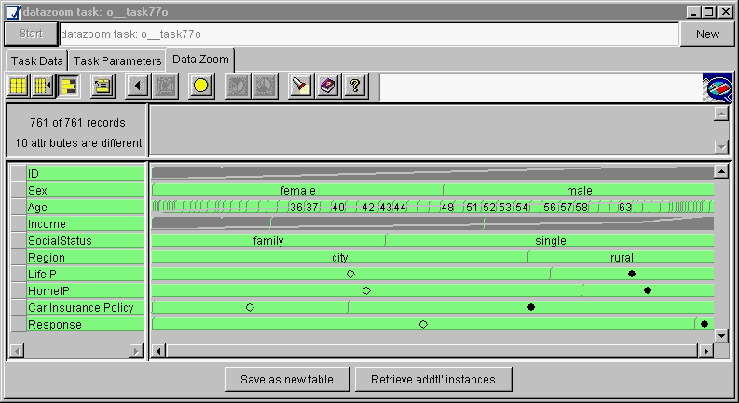
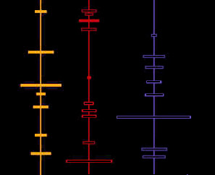
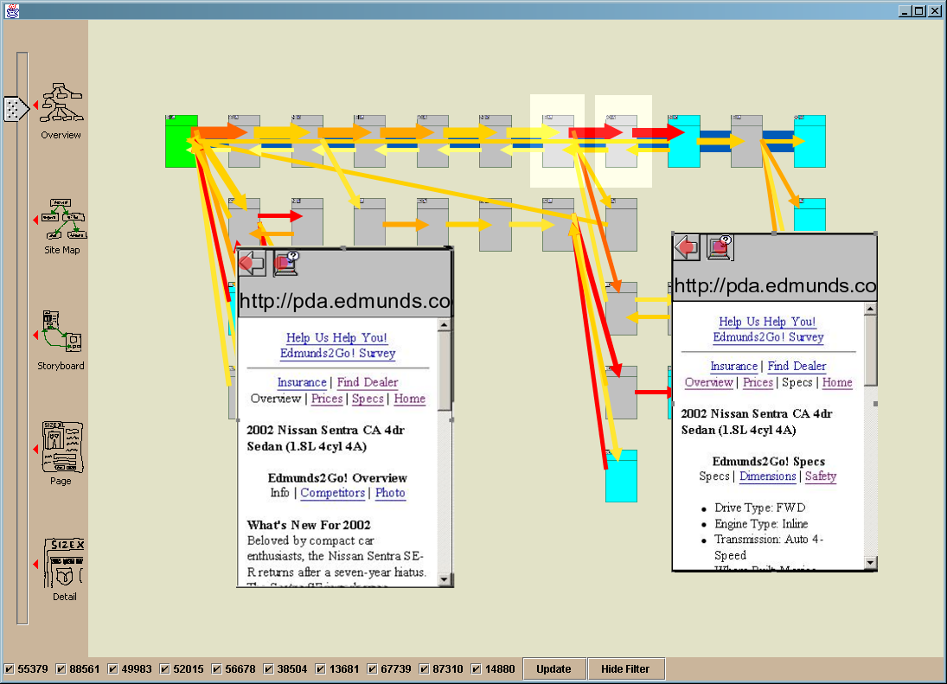
i247: Information Visualization and Presentation
Marti Hearst
Graphing and Basic Statistics

Slide 2
Today
Just for Fun: The Daily Show
Graphing Practice
Basic Statistics in Graphing
Correlations and Scatterplots
Sparklines

Slide 3
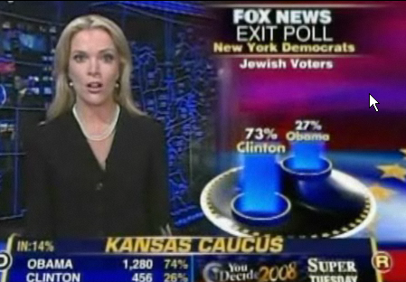
A Daily Show: Full Color Coverage
Ok, I think it’s good that the news outlets are showing charts and graphs and color coding the candidates consistently.
But … then they go crazy!
http://www.thedailyshow.com/video/index.jhtml?videoId=156230&title=full-color-coverage

Slide 4
Class Exercise: Graphing Practice
(Taken from Few’s “Show Me the Numbers”)
  You work for the CFO, who thinks expenses are excessive. Please provide her with a report that shows, for the current quarter, expenses to date compared to what was budgeted, organized by department.

Slide 5
Class Exercise: Graphing Practice
  Create a graph that shows both monthly revenues and monthly expenses, while at the same time highlighting the overall trends for profit over time.

Slide 6
Combining Bar Charts with a Line Graph
(Few 2006)

Slide 7
Means vs Medians
What’s the difference between the median salary in Seattle and the mean (average)?

Slide 8
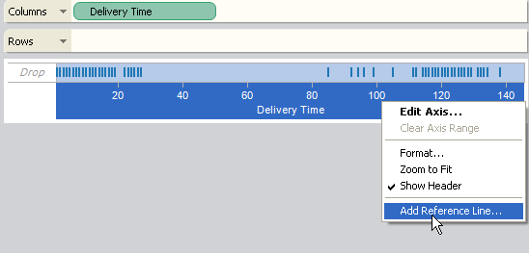
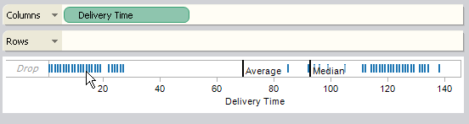
Means and Medians in Tableau

Slide 9
Few’s Comparisons of Data Sets with the Same Medians

Slide 10
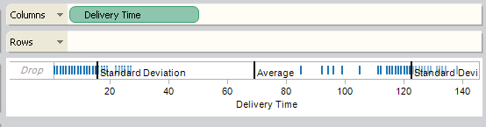
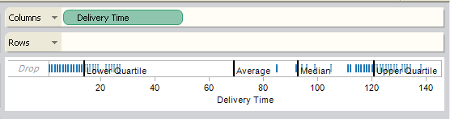
Means and Standard Deviations

Slide 11
An Alternative: Show the Range of the Variance Graphically

Slide 12
Tukey’s Box Plots
(Few 2006)

Slide 13
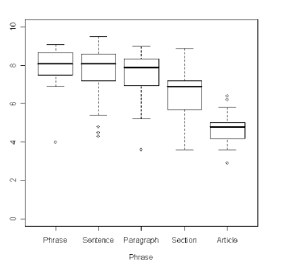
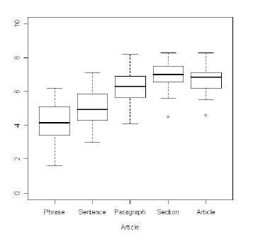
Box Plots in Action
Comparing preferred search result snippet length for different types of queries.

Slide 14
Few’s Bullet Graphs
Goal: Display a key measure along with a comparative measure and qualitative ranges.
An alternative to gauges and meters on dashboards.

Slide 15
Few’s Bullet Graphs

Slide 16
Cascading Bullet Graphs

Slide 17
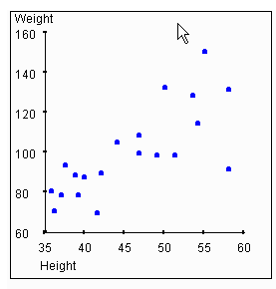
Showing Correlations Through Scatterplots
Example: Height vs Weight

Slide 18
Scatterplot Comparing Two Data Sets (Few 2006)

Slide 19
Scatterplot with Two Trend Lines
(Few 2006)

Slide 20
Correlation
A correlation exists between two variables when one of them is related to the other in some way.
A scatterplot is a graph in which the paired (x,y) sample data are plotted on a graph.
The linear correlation coefficient r measures the strength of the linear relationship.
  Also called the Pearson correlation coefficient.
  Ranges from -1 to 1.
r = 1 represents a perfect positive correlation.
r = 0 represents no correlation
r = -1 represents a perfect negative correlation

Slide 21
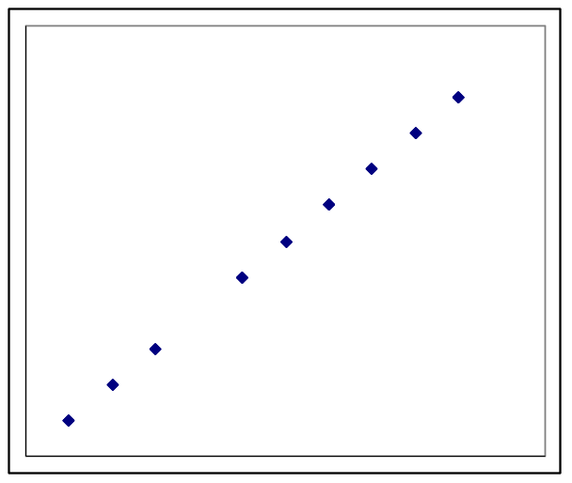
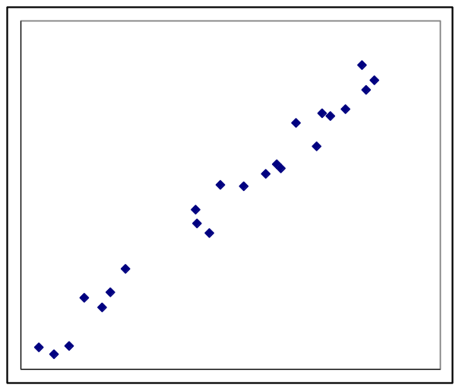
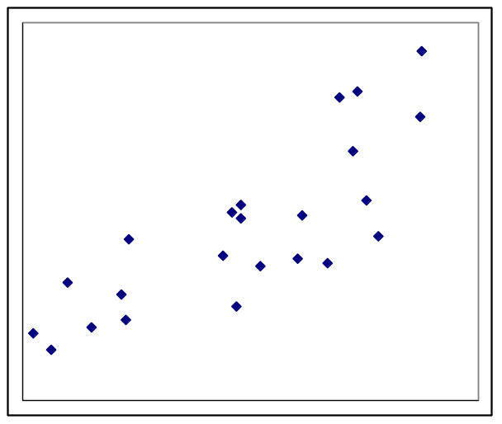
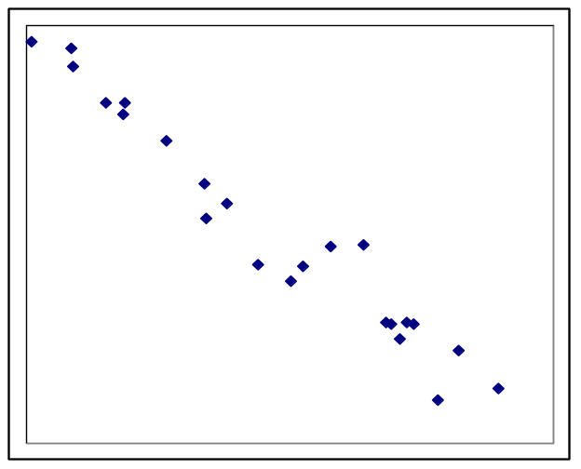
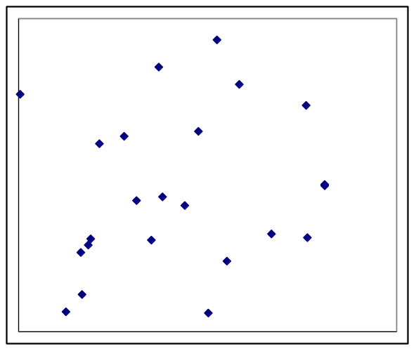
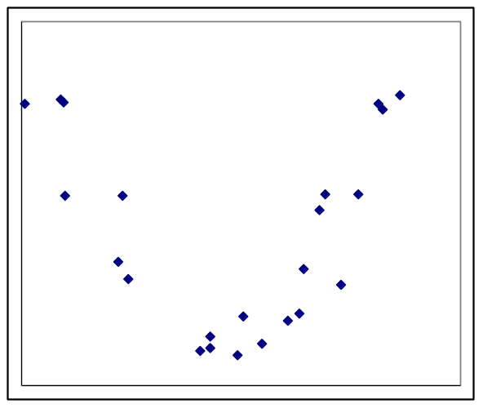
Perfect positive Strong positive Positive
correlation r = 1 correlation r = 0.99 correlation r = 0.80
Strong negative No Correlation Non-linear
correlation r = -0.98 r = 0.16 relationship

Slide 22
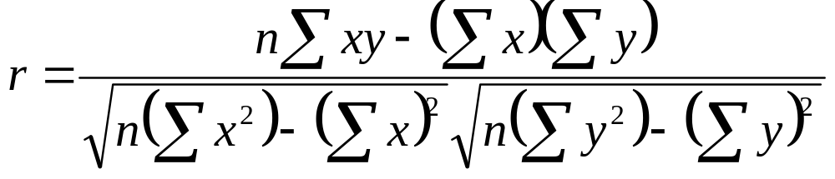
Finding the correlation coefficient
Can compute in excel (r2 in Tableau)

Slide 23
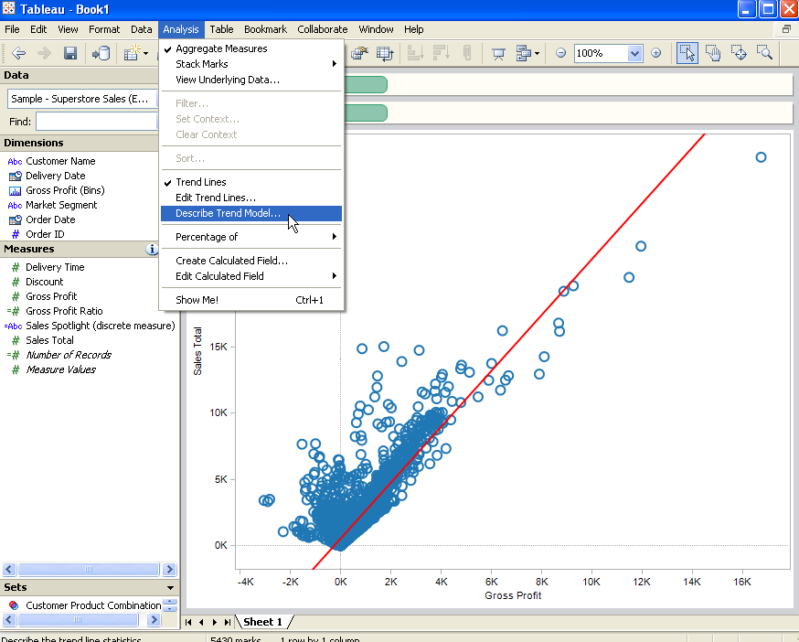
r² in Tableau

Slide 24
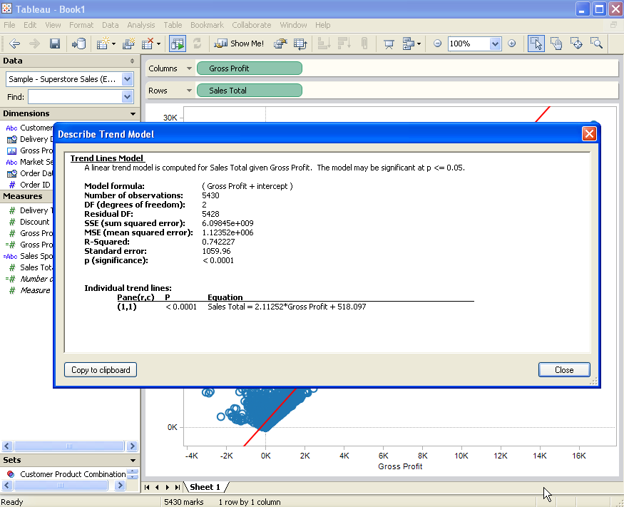
r² in Tableau

Slide 25
Meanings
r² represents the proportion of the variation in y that is explained by the linear relationship between x and y.
Example: Using the heights and weights for a group of people, you find the correlation coefficient to be:
r = 0.796, so r² = 0.634.
So we conclude that about 63.4% of the peoples’ weight can be explained by the relationship between height and weight. This suggests that 36.6% of the variation in weights cannot be explained by height.

Slide 26
Bear in mind:
Correlation does not imply causation.
  For example, there is a strong correlation between golf scores and salaries for CEOs. This does not imply that one can improve their salary by getting better at golf. Often times there are hidden variables, which is something that affects both variables being studied, but is not included in the study.
Beware data based on averages.
  Averages suppress individual variation, and can artificially inflate the correlation coefficient.
Look out for non-linear relationships.
  Just because there is no linear correlation does not mean that the variables might not be related in another way.

Slide 27
Regression
If there is a relationship between x and y, we might want to find the equation of a line that best approximates the data.
This is called the regression line (also called best-fit line or least-squares regression line). We can use this line to make predictions.

Slide 28
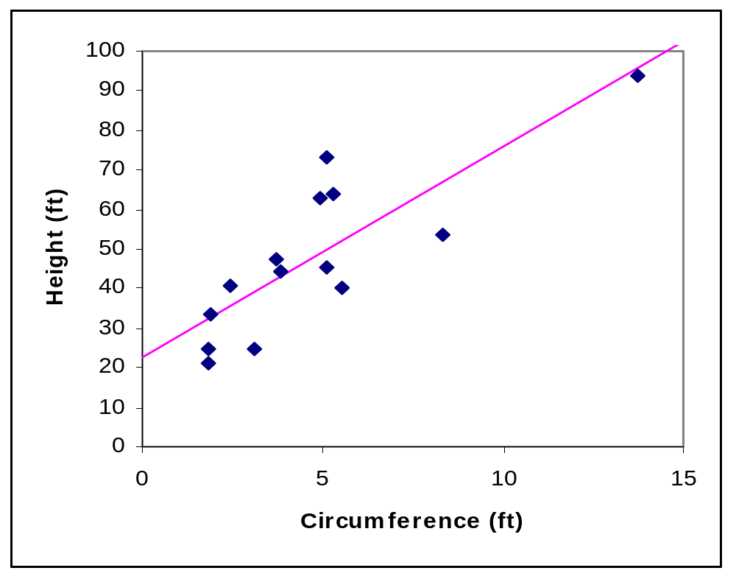
Example: Relationship between Tree Circumference and Height

Slide 29
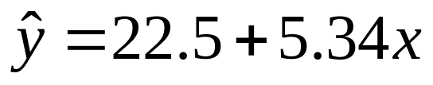
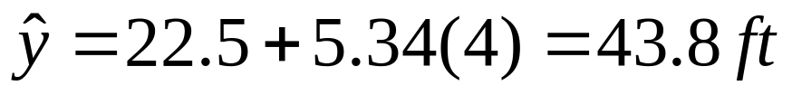
Tree Example
There is a positive correlation between the circumference of a tree and its height (r = 0.828).
The regression line has the equation:
We could use this equation to estimate the height of a tree with circumference 4ft:

Slide 30
Relationship between Tree Circumference and Height
Outliers can strongly influence the graph of the regression line and inflate the correlation coefficient. In the above example, removing the outlier drops the correlation coefficient from
r = 0.828 to r = 0.678.

Slide 31
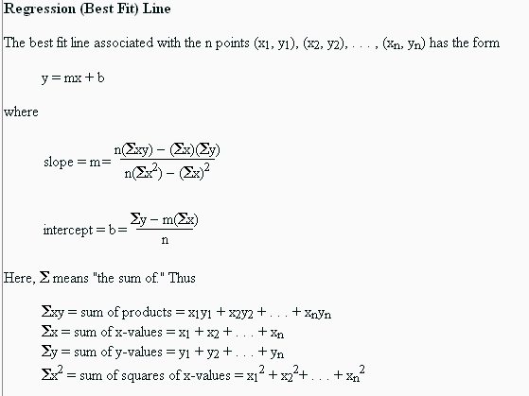
Regression Formulae

Slide 32
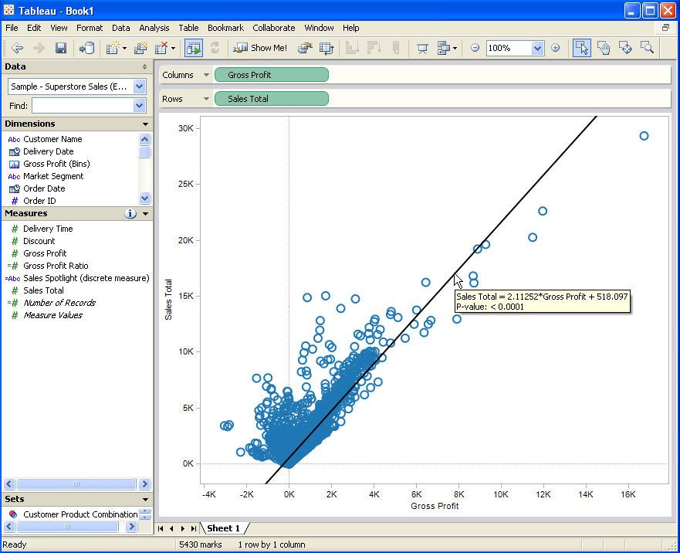
Regression Coefficients in Tableau
Also, significance testing

Slide 33
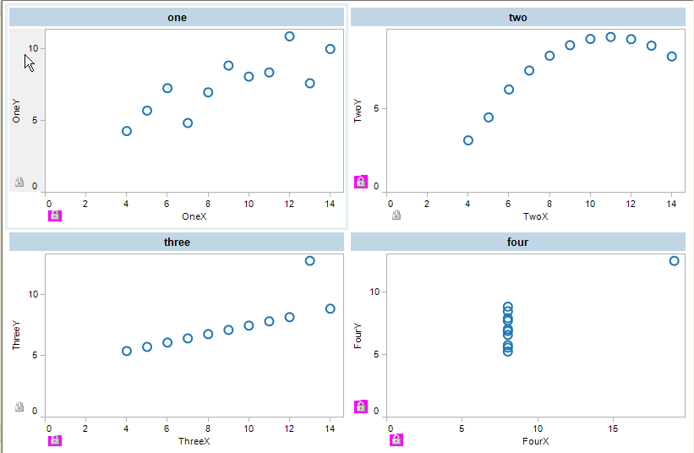
Same Regression Line,
Very Different Distributions
Anscombe: For all 4:
Y=3+0.5X
r2 = .67

Slide 34
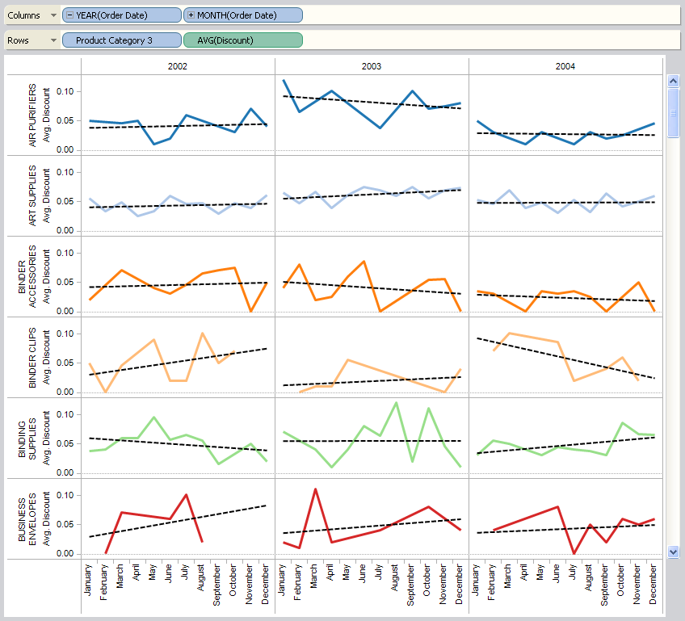

ANOVA in Tableau
http://www.tableausoftware.com/onlinehelp/v3.5/
online/Output/wwhelp/wwhimpl/js/html/wwhelp.htm

Slide 35
Scatter Plot Understandability
Matthew Ericson, NYTimes Graphics Chief, noted that most people don’t understand scatter plots.

Slide 36
Scatter Plot Understandability
Their strategy:
  Use them infrequently
  When you do use them, break them down and explain carefully.

Slide 37
Illustration from NYTimes

Slide 38
Illustration from NYTimes

Slide 39
A Scatter Plot Alternative:
Few’s Correlation Bar Graph

Slide 40
Another Example from Few:
Paired Bar Graph with Trend Lines

Slide 41

Tufte’s Sparklines
Give a hint of the trend, but don’t show the actual axes and scales.
Good for dashboards and small spaces.
  A product call Bonavista microcharts does this nicely in excel
Application: peer2patent.org website

Slide 42
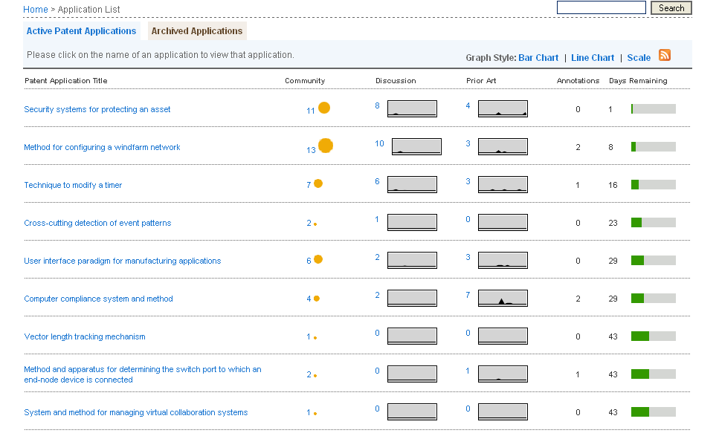
peer2patent.org

Slide 43
Next Two Weeks
Mon 18: Perceptual Principles
  Few Chapter 4
Wed 20: Graphical Excellence
  Tufte pages 16-39
Mon 25: How to Critique a Viz
  Few 96-117
Wed 27: Graphical Integrity
  Tufte pages 53-77
For the Tufte days, bring your book so we can all look at the same illustration
  Each student will lead a discussion of 2 pages of Tufte and do it in 5 minutes.

